Slide 1
Tremen Steel
巨曼钢铁
▶ Carbon & Alloy Tube
▶ Stainless Steel Tube
▶ Copper & Brass Tube
▶ Titanium Tube
▶ Fittings and others
www.tremensteel.com

Slide 2
Tremen Steel could be your best partner on Carbon & Alloy tube, Stainless Tube, Copper & Brass Tube,Titanium Tube and Fittings in China.
▶ Carbon & Alloy Tube
www.tremensteel.com

Slide 3
Carbon & Alloy Steel Tube can be used for conveying water, petroleum, gas and heat exchanger, condenser, and boiler. Standard and Grade
www.tremensteel.com

Slide 4
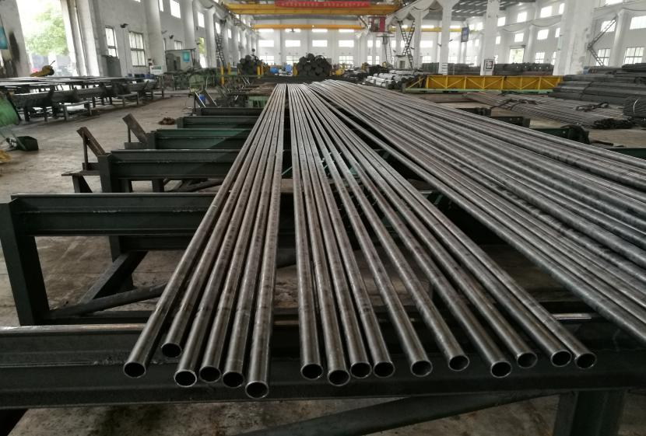
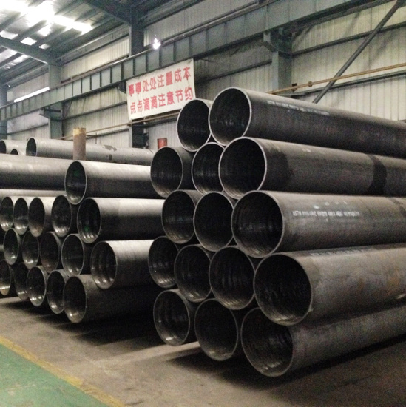
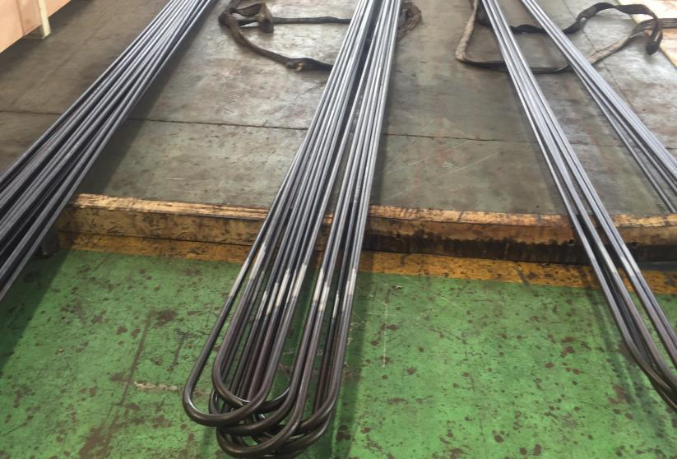
▶ Carbon & Alloy Tube
www.tremensteel.com

Slide 5
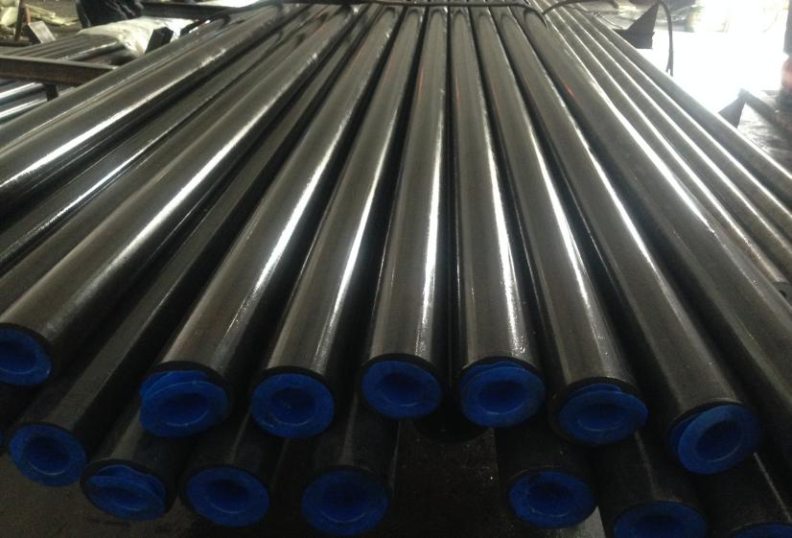
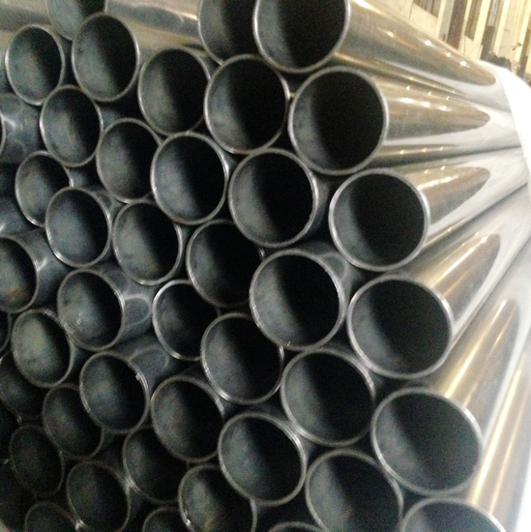
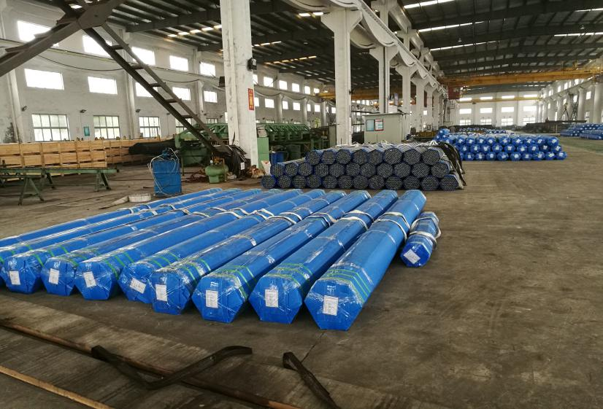
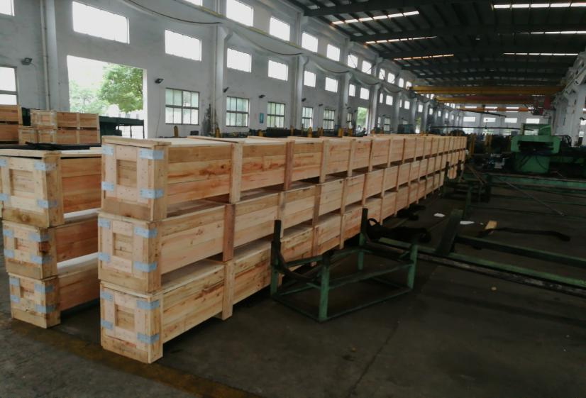
▶ Carbon & Alloy Tube
www.tremensteel.com

Slide 6
▶ Stainless Steel Tube
Tremen Steel could be your best partner on Carbon & Alloy tube, Stainless Tube, Copper & Brass Tube,Titanium Tube and Fittings in China.
www.tremensteel.com

Slide 7
Stainless Steel Tube can be used for conveying water, petroleum, gas and heat exchanger, condenser, and boiler. Standard and Grade
www.tremensteel.com

Slide 8
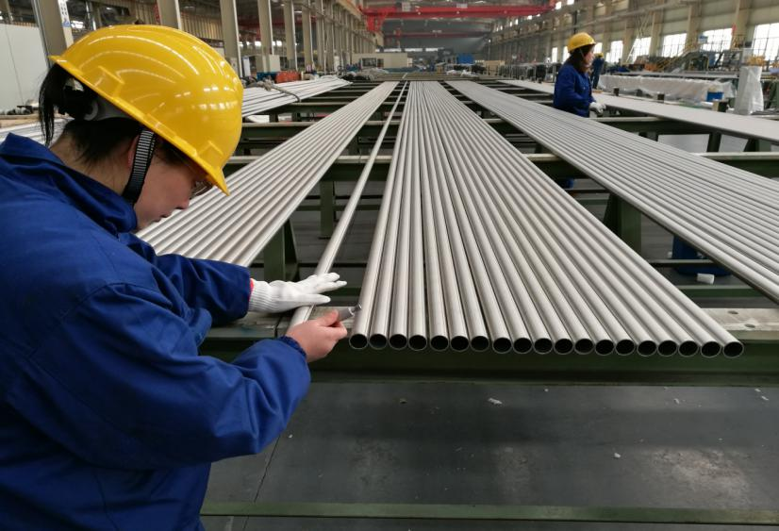
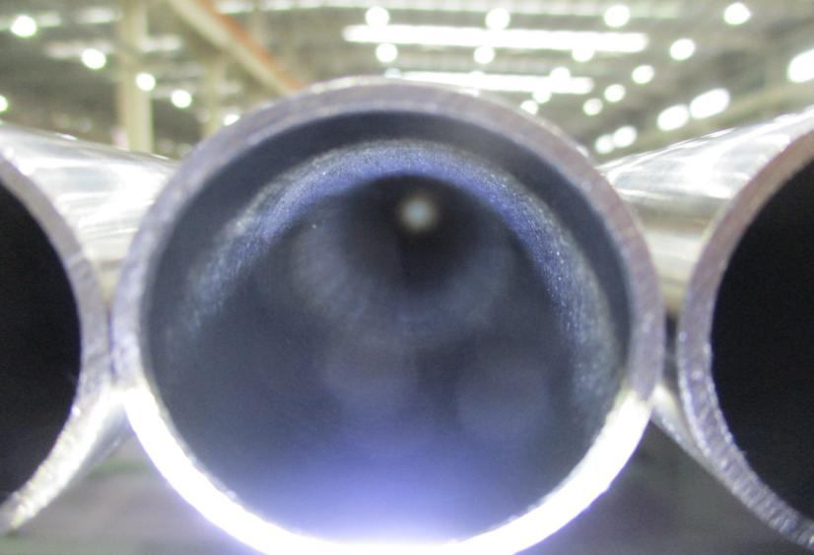
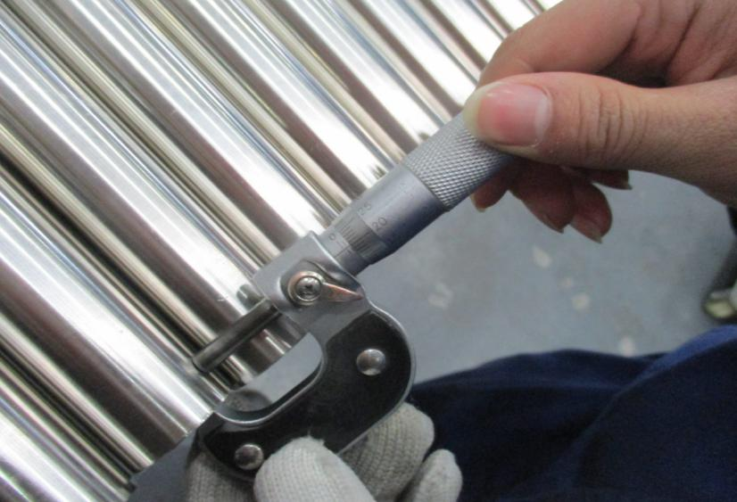
▶ Stainless Steel Tube
www.tremensteel.com

Slide 9
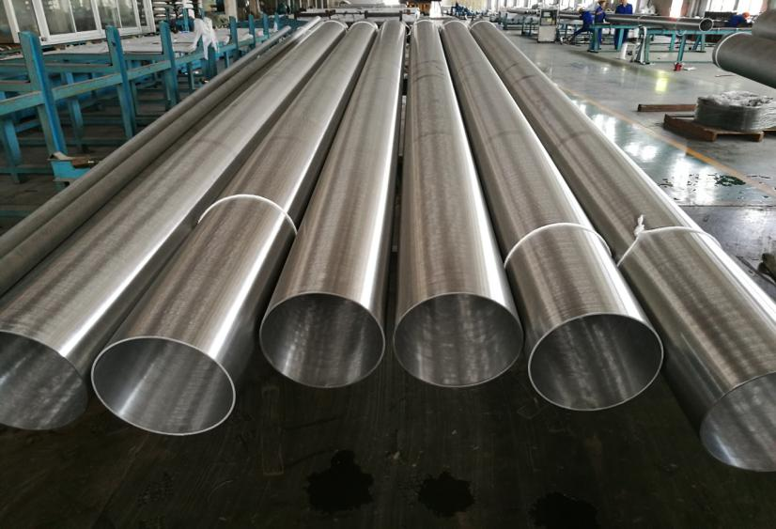
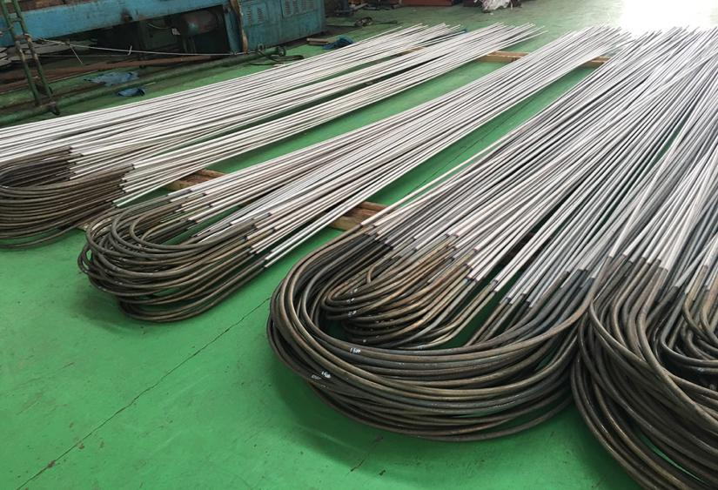
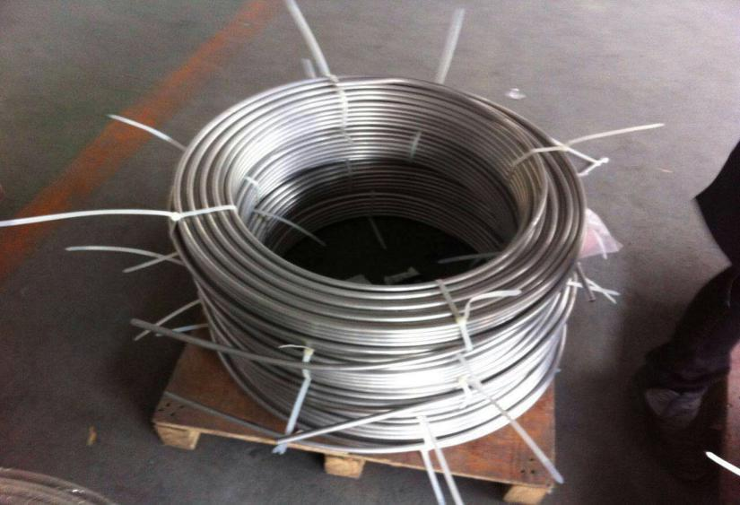
▶ Stainless Steel Tube
www.tremensteel.com

Slide 10
Tremen Steel could be your best partner on Carbon & Alloy tube, Stainless Tube, Copper & Brass Tube,Titanium Tube and Fittings in China.
▶ Copper & Brass Tube
www.tremensteel.com

Slide 11
Copper & Brass Tube can be used for conveying water, petroleum, gas and heat exchanger, condenser, and boiler. Standard and Grade
www.tremensteel.com

Slide 12
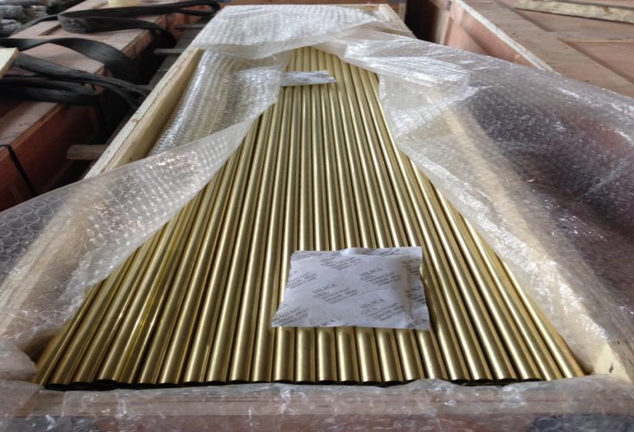
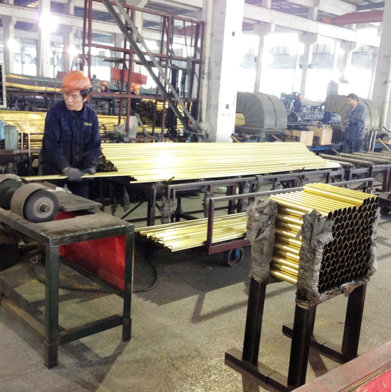
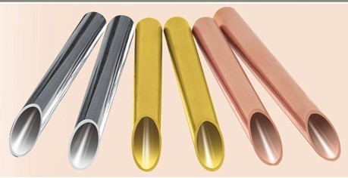
▶ Copper & Brass Tube
www.tremensteel.com

Slide 13
Tremen Steel could be your best partner on Carbon & Alloy tube, Stainless Tube, Copper & Brass Tube,Titanium Tube and Fittings in China.
▶ Titanium Tube
www.tremensteel.com

Slide 14
Titanium Tube can be used for conveying water, petroleum, gas and heat exchanger, condenser, and boiler. Standard and Grade
www.tremensteel.com

Slide 15
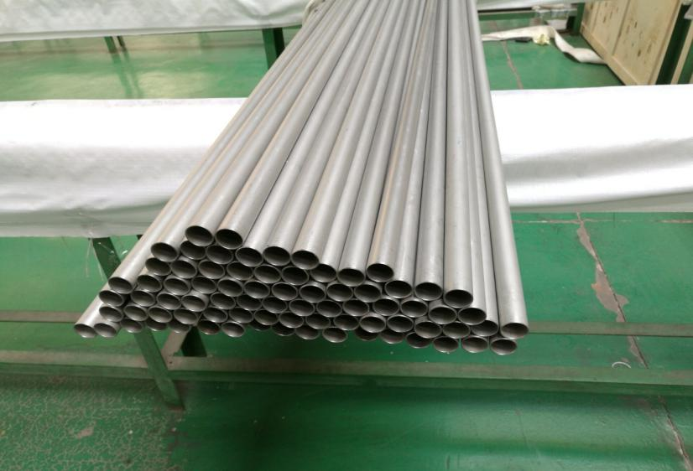
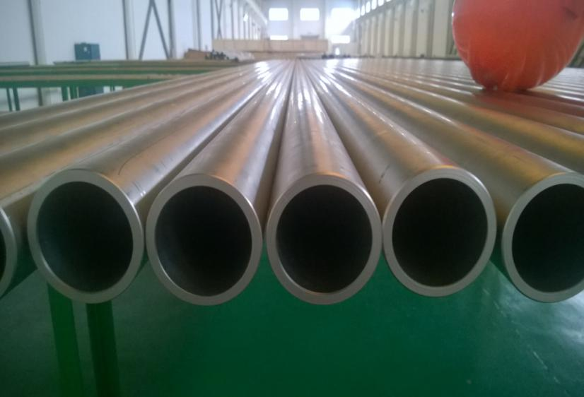
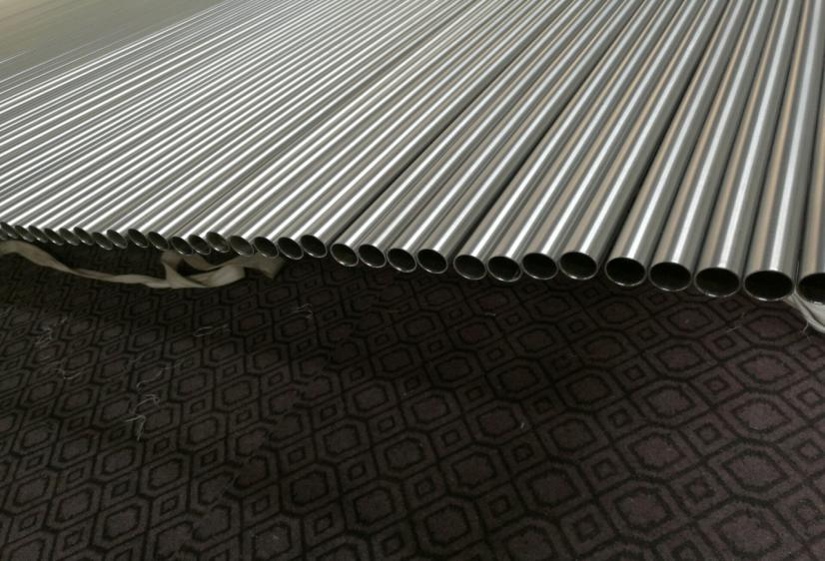
▶ Titanium Tube
www.tremensteel.com

Slide 16
Tremen Steel could be your best partner on Carbon & Alloy tube, Stainless Tube, Copper & Brass Tube,Titanium Tube and Fittings in China.
▶ Fittings and others
www.tremensteel.com

Slide 17
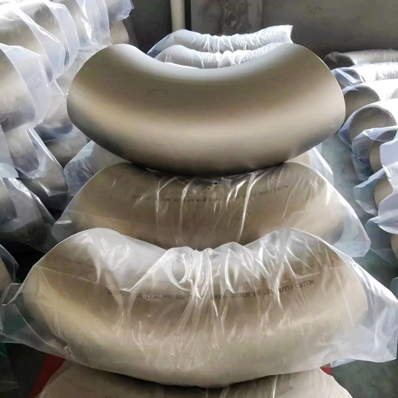
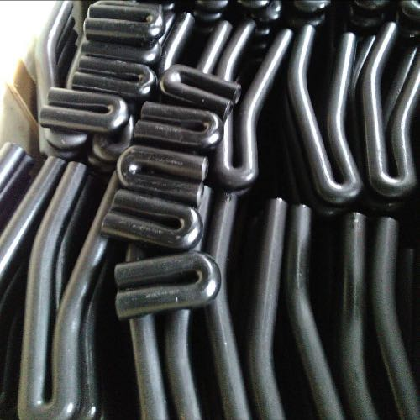
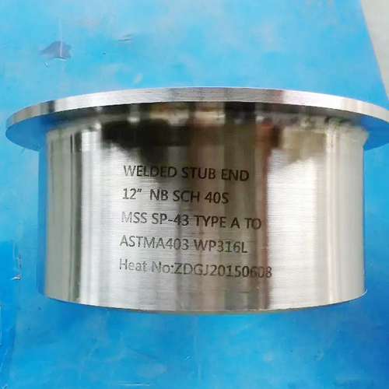
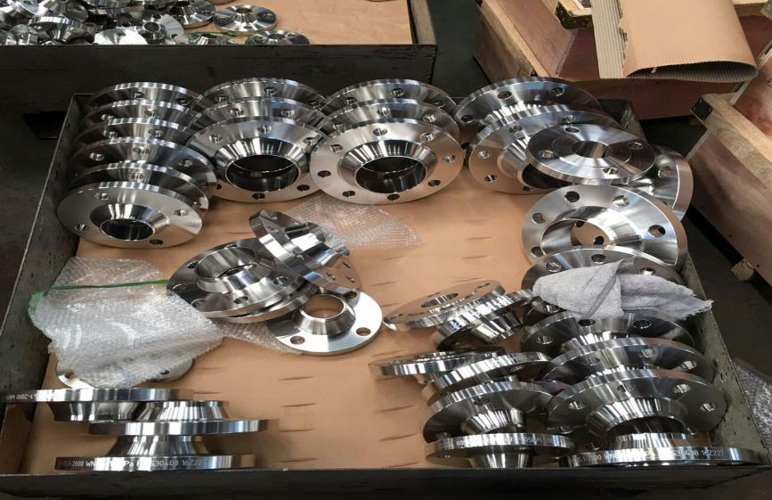
Fittings, Elbows, Bend Tube and others.
www.tremensteel.com

Slide 18
CONTACT US
▶Chain Xu
Sales Manager
Cell: +86-185-5109-0083
E-mail: chain@tremensteel.com
Skype: chain.xu
WhatsApp: +8618551090083
Wechat: xudeqian1983
QQ: 84815919
▶Gabrielle Yang
International Department Manager
Cell: +86-139-1588-3322
E-mail: syang@tremensteel.com
Skype: soso-yang@hotmail.com
WhatsApp: +8613915883322
Fax No.: +86-519-89851850
www.tremensteel.com

